Slide 1
Introduction to Computer Simulation of Physical Systems
(Lecture 6)
Simulating Particle Motion
PHYS 3061

Slide 2
Heat bath
To implement canonical ensemble, we need to fix the temperature.
  Also, such practice can largely reduce the error accumulation in Verlet algorithm.
  Why?

Slide 3
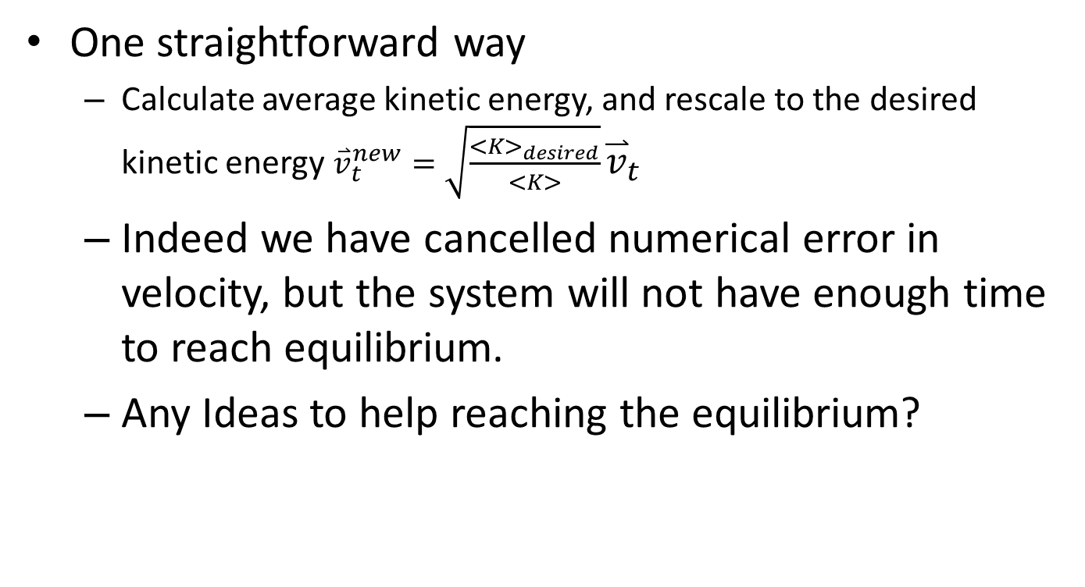
To rescale velocity?
One straightforward way
  Calculate average kinetic energy, and rescale to the desired kinetic energy ${\overset{⃑}{v}}_{t}^{new}=\sqrt{\frac{<K>_{desired}}{<K>}}{\overset{⃑}{v}}_{t}$
  Indeed we have cancelled numerical error in velocity, but the system will not have enough time to reach equilibrium.
  Any Ideas to help reaching the equilibrium?

Slide 4
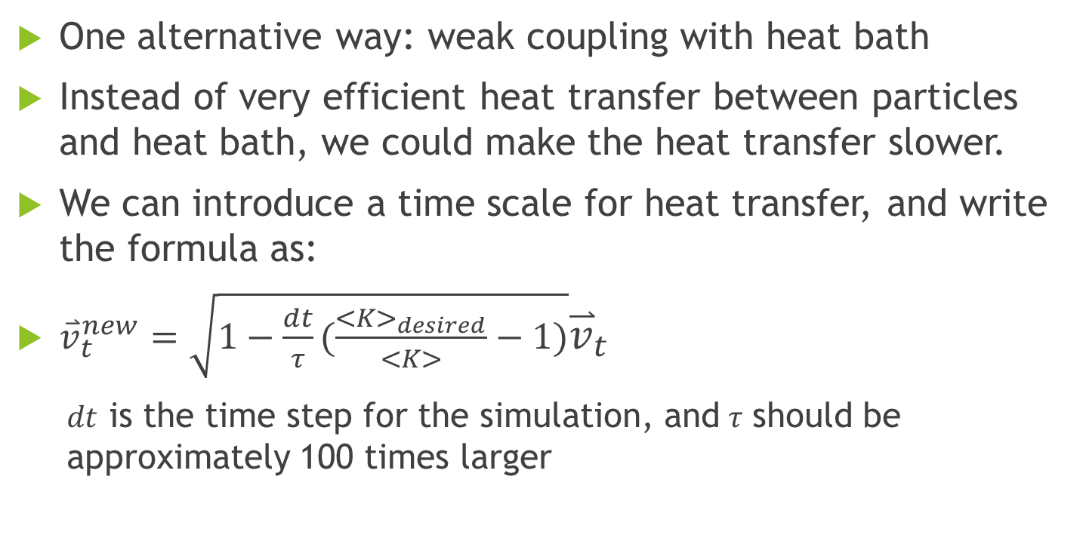
Implementation of heat bath
How to rescale velocity?
One alternative way: weak coupling with heat bath
Instead of very efficient heat transfer between particles and heat bath, we could make the heat transfer slower.
We can introduce a time scale for heat transfer, and write the formula as:
${\overset{⃑}{v}}_{t}^{new}=\sqrt{1−\frac{dt}{τ}(\frac{<K>_{desired}}{<K>}−1)}{\overset{⃑}{v}}_{t}$
  $dt$ is the time step for the simulation, and$τ$ should be approximately 100 times larger

Slide 5
Oscillations

Slide 6
Simple Harmonic Motion
There are many physical systems that undergo regular, repeating motion.
Motion that repeats itself at definite intervals, for example, the motion of the earth about the sun, is said to be periodic.
  Very important concept. In a 3D + time space, periodicity is the translational symmetry along the time axis.
  Stability of emerging phenomenon can be interpreted as a measure of periodicity.

Slide 7
If an object undergoes periodic motion between two limits over the same path, we call the motion oscillatory.
Examples of oscillatory motion:
  a plucked guitar string and the pendulum in a grandfather clock.
  Less obvious examples are microscopic phenomena such as the oscillations of the atoms in crystalline solids.

Slide 8
To illustrate the important concepts associated with oscillatory phenomena, consider a block of mass m connected to the free end of a spring.
The block slides on a frictionless, horizontal surface.
We specify the position of the block by x and take x = 0 to be the equilibrium position of the block,
  that is, the position when the spring is relaxed.

Slide 9
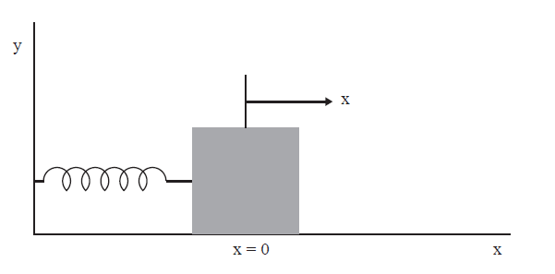
If the block is moved from x = 0 and then released, the block oscillates along a horizontal line.
If the spring is not compressed or stretched too far from x = 0, the force on the block at position x is proportional to x: F = −kx.

Slide 10
The force constant k is a measure of the stiffness of the spring.
The negative sign implies that the force acts to restore the block to its equilibrium position.
Newton’s equation of motion for the block can be written as d²x/dt² = −ω₀²x,
where the angular frequency ω0 is defined by
ω₀² =k/m.

Slide 11
One form of the solution is x(t) = Acos(ω₀t + δ),
  where A and δ are constants and the argument of the cosine is in radians.
The constants A and δ are called the amplitude and the phase respectively,
and are determined by the initial conditions for x and the velocity v = dx/dt.

Slide 12
Because the cosine is a periodic function with period 2π,
we know that x(t) also is periodic.
We define the period T as the smallest time for which the motion repeats itself, that is,
x(t + T) = x(t).
Because ω₀T corresponds to one cycle,
we have
T =2π/ω₀=2π / SQRT(k/m)

Slide 13
The frequency ν of the motion is the number of cycles per second and is given by ν = 1/T .
Note that T depends on the ratio k/m and not on A and δ.
Hence the period of simple harmonic motion is independent of the amplitude of the motion.

Slide 14
Although the position and velocity of the oscillator are continuously changing, the total energy
E remains constant and is given by
E =1/2 mv² +1/2 kx² =1/2kA²

Slide 15
The Motion of a Pendulum
A common example of a mechanical system that exhibits oscillatory motion is the simple pendulum.
A simple pendulum is an idealized system consisting of a particle or bob of mass m attached to the lower end of a rigid rod of length L and negligible mass;
the upper end of the rod pivots without friction.
If the bob is pulled to one side from its equilibrium position and released,
  the pendulum swings in a vertical plane.

Slide 16
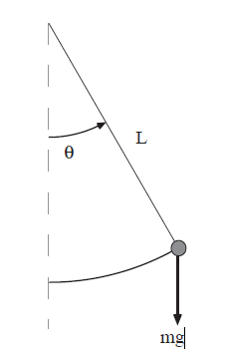
velocity and acceleration of the bob as measured along the arc are given by
v = Ldθ/dt
a = Ld²θ/dt²
In the absence of friction, two forces act on the bob: the force mg vertically downward and the force of the rod which is directed inward to the center if |θ| < π/2.
Note that the effect of the rigid rod is to constrain the motion of the bob along the arc.
We can see that the component of mg along the arc is mg sin θ in the direction of decreasing θ.

Slide 17
Hence, the equation of motion can be written as
(mL) d²θ/dt² = −mg sin θ,
or
d²θ/dt² = − (g/L) sin θ.

Slide 18
an example of a nonlinear equation because sin θ rather than θ appears.
Most nonlinear equations do not have analytical solutions in terms of well-known functions.
However, if the amplitude of the pendulum oscillations is sufficiently small, then sin θ ≈ θ,
d²θ/dt²≈ − (g/L) θ.

Slide 19
the period of a pendulum is given by
T = 2π SQRT(L/g).
Because we know that the numerical solutions must be consistent with conservation of energy,
we derive the form of the total energy here.
The potential energy can be found from the following considerations.
If the rod is deflected by the angle θ, then the bob is raised by the distance h = L−Lcos θ

Slide 20
Hence, the potential energy of the bob in the gravitational field of the earth is
U = mgh = mgL(1 − cos θ),
where the zero of the potential energy corresponds to θ = 0.
Because the kinetic energy of the pendulum is
1/2mv² = 1/2mL²(dθ/dt)²,
the total energy E of the pendulum is
E =1/2mL²(dθ/dt)²+ mgL(1 − cos θ).

Slide 21
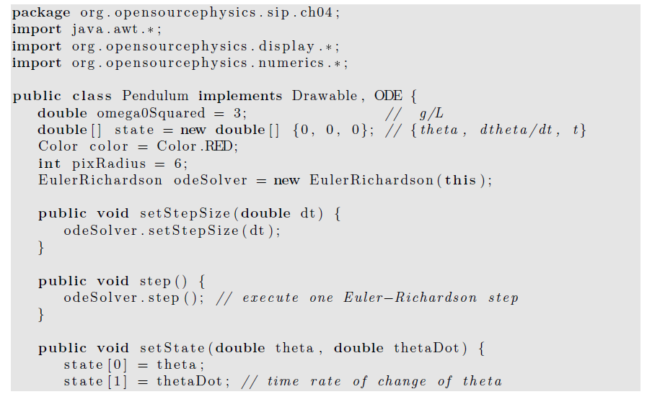

Slide 22
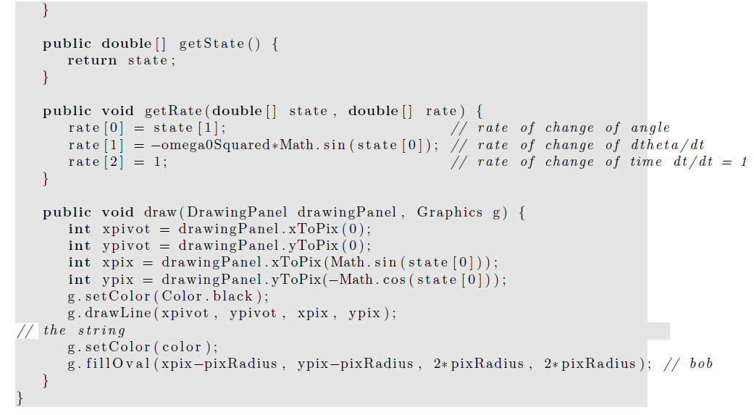

Slide 23
Damped Harmonic Oscillator
We know from experience that most oscillatory motion in nature gradually decreases until the displacement becomes zero; such motion is said to be damped and the system is said to be dissipative rather than conservative.

Slide 24
As an example of a damped harmonic oscillator, consider the motion of the block when a horizontal drag force is included.
For small velocities, it is a reasonable approximation to assume that the drag force is proportional to the first power of the velocity.
In this case the equation of motion can be written as
d²x/dt² = −ω₀²x − γ dx/dt.

Slide 25
The damping coefficient γ is a measure of the magnitude of the drag term.
Note that the drag force opposes the motion.

Slide 26
Response to External Forces
How can we determine the period of a pendulum that is not already in motion?
The obvious way is to disturb the system, for example, to displace the bob and observe its motion.
We will find that the nature of the response of the system to a small perturbation tells us something about the nature of the system in the absence of the perturbation.

Slide 27
Consider the driven damped linear oscillator with an external force F(t) in addition to the linear restoring force and linear damping force.
The equation of motion can be written as
d²x/dt² = −ω₀²x − γv +(1/m)F(t).

Slide 28
It is customary to interpret the response of the system in terms of the displacement x rather than the velocity v.
The time dependence of F(t) is arbitrary.
Because many forces in nature are periodic, we first consider the form
(1/m)F(t) = A₀ cos ωt, where ω is the angular frequency of the driving force.

Slide 29
the response of the damped harmonic oscillator to an external driving force is linear.
For example, if the magnitude of the external force is doubled, then the magnitude of the steady state motion also is doubled.
This behavior is a consequence of the linear nature of the equation of motion.
When a particle is subject to nonlinear forces, the response can be much more complicated.

Slide 30
a phase space plot for a single oscillator.
This plot provides a convenient representation of both the position and velocity.
When we study chaotic phenomena such plots will become almost indispensable.
Here we will consider an important feature of phase space trajectories for conservative systems.

Slide 31
If there are no external forces, the undamped simple harmonic oscillator and undamped pendulum are examples of conservative systems, that is, systems for which the total energy is a constant.
Two general properties of conservative systems:
  the nonintersecting nature of their trajectories in phase space and the preservation of area in phase space.
These concepts become more important when we study the properties of conservative systems with more than one degree of freedom.

Slide 32
Electrical Circuit Oscillations
In this section we discuss several electrical analogues of the mechanical systems that we have considered.
Although the equations of motion are similar in form, it is convenient to consider electrical circuits separately, because the nature of the questions of interest is somewhat different.

Slide 33
The starting point for electrical circuit theory is Kirchhoff’s loop rule,
which states that the sum of the voltage drops around a closed path of an electrical circuit is zero.
This law is a consequence of conservation of energy,
because a voltage drop represents the amount of energy that is lost or gained when a unit charge passes through a circuit element.
The relations for the voltage drops across each circuit element are summarized in Table on next page.

Slide 34
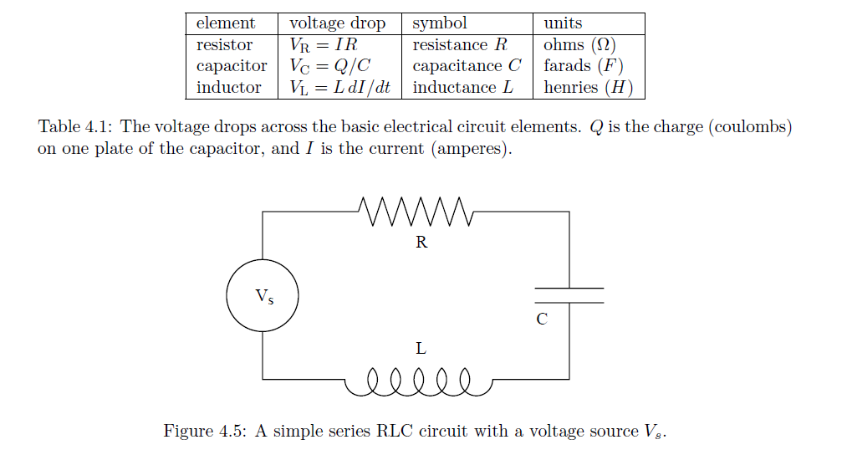

Slide 35
Imagine an electrical circuit with an alternating voltage source V_{s}(t) attached in series to a resistor, inductor, and capacitor.
The corresponding loop equation is V_{L} + V_{R} + V_{C} = V_{s}(t).
L d²Q/dt2 + RdQ/dt+Q/C= Vs(t),
We see that the series RLC circuit is identical in form to the damped harmonic oscillator.
The analogies between ideal electrical circuits and mechanical systems are summarized in Table on next page

Slide 36
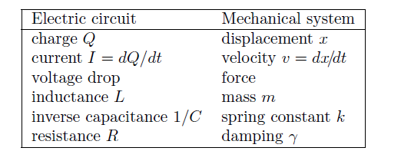

Slide 37
Accuracy and Stability
We have learned how to use numerical methods to find numerical solutions to simple first-order differential equations,
we need to develop some practical guidelines to help us estimate the accuracy of the various methods.

Slide 38
Because we have replaced a differential equation by a difference equation, our numerical solution is not identically equal to the true solution of the original differential equation, except for special cases.
The discrepancy between the two solutions has two causes.
One cause is that computers do not store numbers with infinite precision, but rather to a maximum number of digits that is hardware and software dependent.

Slide 39
As we have seen, Java allows the programmer to distinguish between floating point numbers, that is, numbers with decimal points, and integer numbers.
Arithmetic with numbers represented by integers is exact, but we cannot solve a differential equation using integer arithmetic.
Arithmetic operations involving floating point numbers, such as addition and multiplication, introduce roundoff error.

Slide 40
For example, if a computer only stored floating point numbers to two significant figures, the product 2.1 × 3.2 would be stored as 6.7 rather than 6.72.
The significance of roundoff errors is that they accumulate as the number of mathematical operations increases.
Ideally, we should choose algorithms that do not significantly magnify the roundoff error,
for example, we should avoid subtracting numbers that are nearly the same in magnitude.

Slide 41
The other source of the discrepancy between the true answer and the computed answer is the error associated with the choice of algorithm.
This error is called the truncation error.
A truncation error would exist even on an idealized computer that stored floating point numbers with infinite precision and hence had no roundoff error.

Slide 42
Because the truncation error depends on the choice of algorithm and can be controlled by the programmer, you should be motivated to learn more about numerical analysis and the estimation of truncation errors.
However, there is no general prescription for the best algorithm for obtaining numerical solutions of differential equations.

Slide 43
We will find in later chapters that the various algorithms have advantages and disadvantages,
and the appropriate selection depends on the nature of the solution,
  which you might not know in advance, and on your objectives.
How accurate must the answer be?
Over how large an interval do you need the solution?
What kind of computer(s) are you using?
How much computer time and personal time do you have?

Slide 44
In practice, we usually can determine the accuracy of a numerical solution
  by reducing the value of Δt
    until the numerical solution is unchanged at the desired level of accuracy.
We have to be careful
  not to make Δt too small,
    because too many steps would be required
    the computation time and roundoff error would increase.

Slide 45
In addition to accuracy, another important consideration is the stability of an algorithm.
It might happen that the numerical results are very good for short times, but diverge from the true solution for longer times.
  Any examples?
This divergence might occur if small errors in the algorithm are multiplied many times, causing the error to grow geometrically.
Such an algorithm is said to be unstable for the particular problem.

Slide 46
Alternative option for final project
  In the case that your MD simulation doesn’t work.
  Create a simulation of a damped oscillating system
    Choose suitable parameters
  Implement different algorithms
    Euler method
    Euler-Richardson method
    Verlet method
  Compare the results with the theoretical values
    investigate characteristic quantities of the system, eg. energy, period, etc.

Slide 47
Homework 1 (Due in two weeks after this lecture)
Modify the LJ potential force in your lab3 code to gravitational force
Simulate the Sun-Earth-Moon 3 body system
  Use appropriate unit of length, mass and time. Label them in your source code
  You can assume circular orbits and all orbits are in the same plane
Make an animation of the system for first 100 years
Plot the trajectories of Moon around Sun, Moon around Earth and Earth around Sun for 10 years.
plot the average distance between moon and earth for every 500 years in a 100,000 years simulation
You need to submit: source code, plot and txt file(s) of trajectories , .xyz animation, plot and .txt file of average distance via online submission system.

Slide 48
The Chaotic Motion of Dynamical
Systems

Slide 49
Introduction
Most natural phenomena are intrinsically nonlinear.
  Weather patterns
  the turbulent motion of fluids
It is easy to introduce some of the important concepts in the context of ecology.
Our first goal:
  analyze the one-dimensional difference equation
  x_{n+1} = 4rx_{n}(1 − x_{n}),
  where x_{n} is the ratio of the population in the nth generation to a reference population.

Slide 50
The dynamical properties are surprisingly intricate
  important implications for the development of a more general description of nonlinear phenomena.

Slide 51
quote from the ecologist Robert May:
“Its study does not involve as much conceptual sophistication as does elementary calculus. Such study would greatly enrich the student’s intuition about nonlinear systems. Not only in research but also in the everyday world of politics and economics we would all be better off if more people realized that simple nonlinear systems do not necessarily possess simple dynamical properties.”

Slide 52
The study of chaos: much current interest,
  but the phenomena is not new
  has been of interest, particularly to astronomers and mathematicians, for over one hundred years.
Much of the current interest:
  due to the use of the computer
    making empirical observations.
We will use the computer in this spirit.
  What do you expect will be a problem in computer simulations of chaotic systems?

Slide 53
A Simple One-Dimensional Map
Imagine an island
  with an insect population
    breeds in the summer
    leaves eggs that hatch the following spring.
The population growth occurs at discrete times => appropriate to model the population growth
  by a difference equation
  rather than by a differential equation.

Slide 54
Simple model:
  population growth:
    the population in generation n+1 to the population in generation n is given by
    P_{n+1} = aP_{n},
    P_{n} is the population in generation n and a is a constant.
Assume that
  the time interval between generations is unity,
  refer to n as the time.

Slide 55
If a < 1,
  the population decreases at each generation
  eventually the population becomes extinct.
If a > 1,
  each generation will be a times larger than the previous one.
  geometrical growth and an unbounded population.

Slide 56
Although the unbounded nature of geometrical growth is clear,
  it is remarkable
    most of us do not integrate our understanding of geometrical growth into our everyday lives.
    Can a bank pay 4% interest each year indefinitely?
    Can the world’s human population grow at a constant rate forever?

Slide 57
natural to formulate a more realistic model
  the population is bounded by the finite carrying capacity of its environment.
  A simple model of density-dependent growth is P_{n+1} = P_{n}(a − bP_{n}).

Slide 58
nonlinear due to the presence of the quadratic term in P_{n}.
The linear term: the natural growth of the population;
the quadratic term: a reduction of this natural growth
  for example, caused by overcrowding or by the spread of disease.

Slide 59
convenient to rescale the population
  by letting P_{n} = (a/b)x_{n}
  x_{n+1} = ax_{n}(1 − x_{n})
The replacement of P_{n} by x_{n} changes the units.
In the standard form,
  the parameter r = a/4
  And x_{n+1} = f(x_{n}) = 4rx_{n}(1 − x_{n}).

Slide 60
The rescaled form has the desirable feature
  its dynamics are determined by a single control parameter r
  instead of the two parameters a and b.
Note that if x_{n} > 1, x_{n+1} will be negative!

Slide 61
To avoid this unphysical feature,
  we impose the conditions
    that x is restricted to the interval 0 ≤ x ≤ 1 and 0 < r ≤ 1.
Because the function f(x) transforms any point on the one-dimensional interval [0, 1] into another point in the same interval, the function f is called a one-dimensional map.

Slide 62
The form of f(x) is known as the logistic map.
The logistic map is a simple example of a dynamical system,
  the map is a deterministic, mathematical prescription for finding the future state of a system given its present state.

Slide 63
The sequence of values x₀, x₁, x₂, . . . is called the trajectory.
To check your understanding, suppose that the initial value of x₀ or seed is x₀ = 0.5 and r = 0.2.
The trajectory is: x1 = 0.2, x2 = 0.128, x3 = 0.089293, …

Slide 64
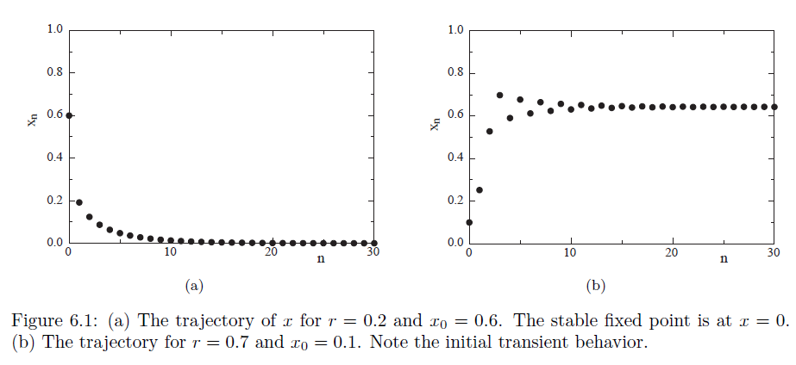
The first thirty iterations are shown for two values of r here.

Slide 65
The class IterateMapApp computes the trajectory of the logistic map.
It extended the AbstractCalculation class,
  because many of the results were discovered using a programmable calculator.

Slide 66
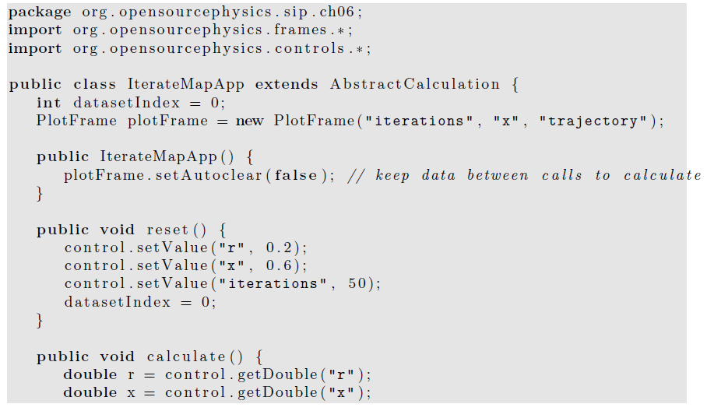

Slide 67
